Slide 1



Visualizing Carbon Footprints using Power BI
Presented By : Kanak Garg

Slide 2

Learning Objectives
Analyze Carbon Footprint Data: Understand the various components contributing to carbon emissions.
Visualize Trends and Patterns: Use Power BI to create visual representations of data for better comprehension.
Identify Key Emission Sources: Pinpoint which sectors (e.g., transportation, energy) contribute most to carbon footprints.
Engage Stakeholders: Present findings to stakeholders to promote awareness and action.
Develop Actionable Insights: Provide recommendations based on data analysis to help reduce carbon emissions.
Foster Sustainable Practices: Encourage the adoption of sustainable practices based on visualized data insights.
GOAL
Source :
www.freepik.com/

Slide 3
Tools and Technology used
Power BI:
Primary tool for data visualization and analysis.
Features include data modeling, interactive dashboards, and real-time data updates.
Power Query:
Used for data extraction, transformation, and loading (ETL).
Facilitates data cleaning, merging, and shaping before analysis.
DAX (Data Analysis Expressions):
A formula language used in Power BI for creating custom calculations and aggregations.
Enables advanced data analysis and insights generation.
Data Sources:
Utilized various data sources such as:
CSV files for raw data import.
Excel spreadsheets for structured data.
APIs for real-time data retrieval from environmental databases.
Visualization Tools:
Bar charts, line graphs, and maps created using Power BI’s built-in visualization options.
Custom visuals from the Power BI marketplace to enhance data representation.
Collaboration Tools:
Microsoft Teams or SharePoint for team collaboration and sharing insights.
Power BI Service for publishing and sharing reports with stakeholders.

Slide 4
Methodology
Data Collection:
Gathered data from multiple sources, including:
Environmental reports and studies.
Government databases and public datasets.
Surveys and questionnaires targeting specific sectors.
Data Cleaning:
Conducted data validation to ensure accuracy and reliability.
Removed duplicates and irrelevant entries.
Handled missing values through imputation or exclusion.
Data Transformation:
Utilized Power Query for data transformation tasks:
Merged datasets from different sources for a comprehensive view.
Standardized data formats (e.g., date formats, units of measurement).
Created calculated columns for additional insights (e.g., total emissions).
Data Modeling:
Developed a data model in Power BI to establish relationships between different data tables.
Created hierarchies for better drill-down capabilities in visualizations.

Slide 5
Problem Statement:
Rising Carbon Emissions: Global carbon emissions are increasing at an alarming rate, contributing to climate change and environmental degradation.
Lack of Awareness: Many individuals and organizations are unaware of their carbon footprints and the impact of their activities on the environment.
Data Fragmentation: Carbon footprint data is often scattered across various sources, making it difficult to analyze and derive actionable insights.
Need for Effective Visualization: Traditional reporting methods fail to effectively communicate complex carbon data, hindering understanding and decision-making.
Urgency for Action: There is an urgent need for tools and strategies to visualize carbon footprints, enabling stakeholders to identify key areas for reduction and promote sustainable practices.

Slide 6
Solution:
Comprehensive Data Analysis:
Utilize Power BI to aggregate and analyze carbon footprint data from multiple sources, providing a holistic view of emissions.
Interactive Visualizations:
Create dynamic dashboards and visualizations that simplify complex data, making it easier for stakeholders to understand their carbon footprints.
Awareness and Education:
Develop educational materials and presentations based on visual insights to raise awareness about carbon emissions and their impact on the environment.
Actionable Insights:
Provide clear recommendations based on data analysis, highlighting specific areas where organizations and individuals can reduce their carbon footprints.
Stakeholder Engagement:
Facilitate workshops and discussions using the visualized data to engage stakeholders in sustainability initiatives and encourage collaborative action towards emission reduction.

Slide 7
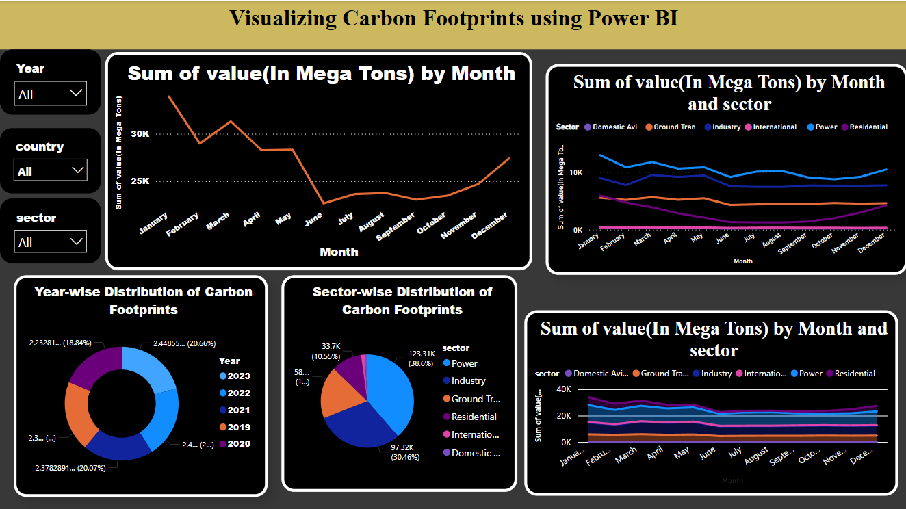
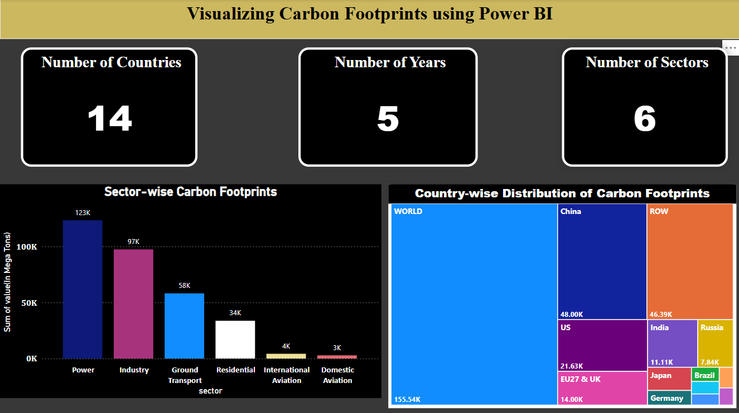
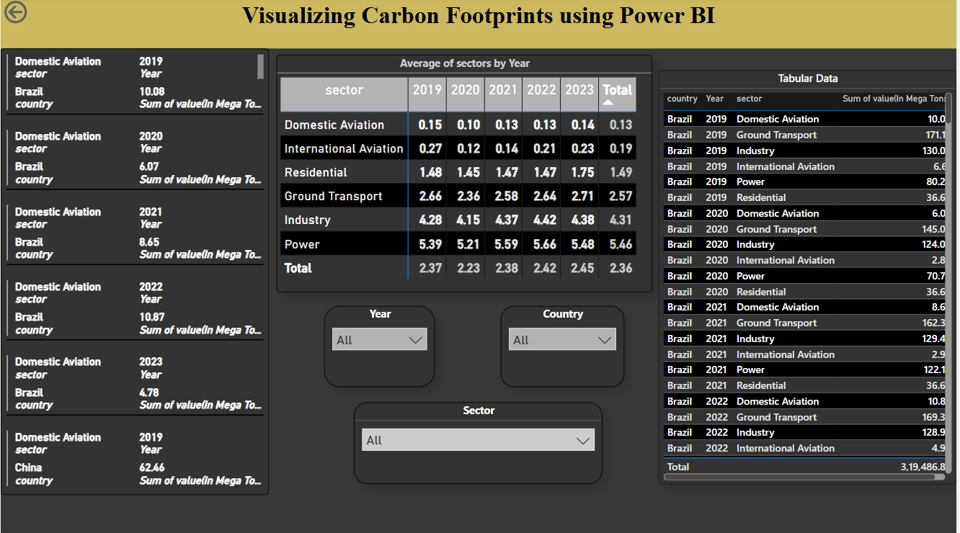
Screenshot of Output:
The dashboards include: - CO₂ Emissions by Sector - Year-over-Year Comparison - Regional Emissions Distribution

Slide 8
Conclusion:
Summary of Findings:
Recap the key insights gained from the analysis of carbon footprint data, highlighting significant trends and areas of concern.
Importance of Visualization:
Emphasize how effective data visualization using Power BI enhances understanding and facilitates informed decision-making regarding carbon emissions.
Call to Action:
Encourage the audience to take proactive steps in reducing their carbon footprints and adopting sustainable practices based on the insights presented.
Future Directions:
Suggest areas for further research and analysis to continue improving carbon footprint understanding and reduction strategies.
Acknowledgment of Collaboration:
Thank collaborators, stakeholders, and data sources that contributed to the project’s success.
Access to Project Files:
For more details and access to the project files, visit: https://github.com/Kanak1009/Carbon-Footprints.git

